Slide 1

Presentation Outline
Vehicle detection progress
Signalman detection progress
June 3, 2022
SmartInsideAI

Slide 2
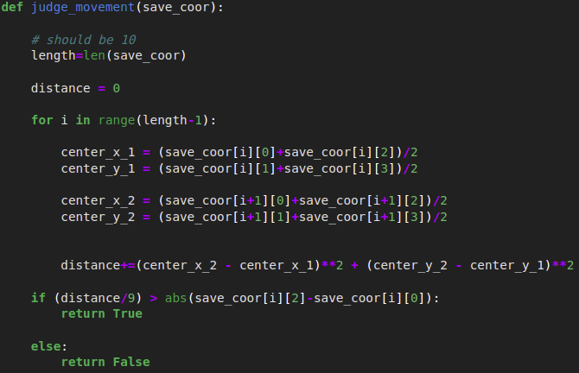
Vehicle detection progress
Vehicle movement detection
X <- inputImage
threshold <- confidentThreshold
bboxes <- vehicleDetectionModel(X)
coorList = []
for each x,row in bboxes do
if row[-1] > threshold then
croppedImage = X[row[1]:row[3], row[0]:row[2]]
excavatorHead <- excavatorHeadDetectionModel(croppedImage)
coorList.append(excavatorHead) % Append Excavator head coordinate
if len(coorList) == 10 then % check 10 frame per time
movementChecking <- estimateTheMovement(coorList)
coorList = []
end if
end if
end For
June 3, 2022
SmartInsideAI

Slide 3
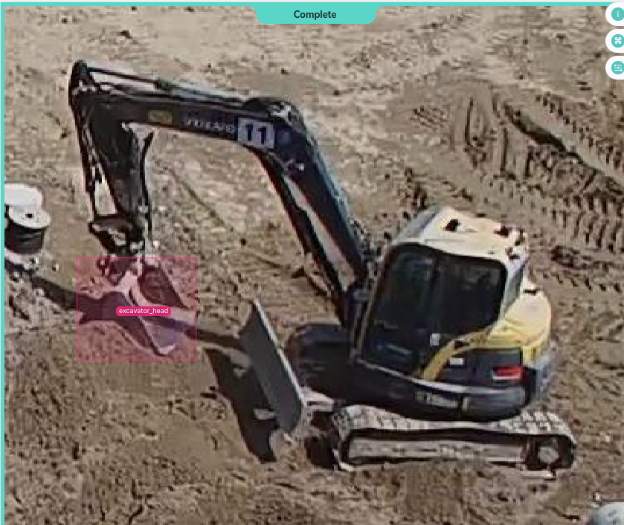
Vehicle detection progress
Excavator head detection model
June 3, 2022
SmartInsideAI

Slide 4
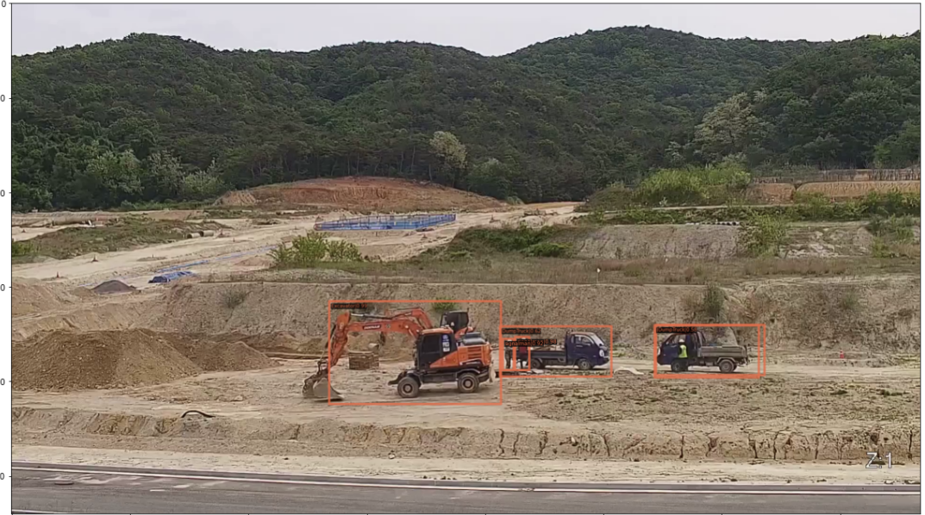
Vehicle detection progress
June 3, 2022
SmartInsideAI

Slide 5
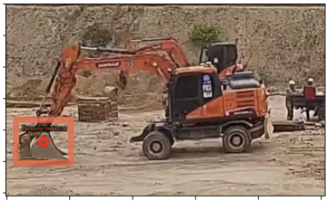
Vehicle detection progress
Detect center point of excavator head
June 3, 2022
SmartInsideAI

Slide 6
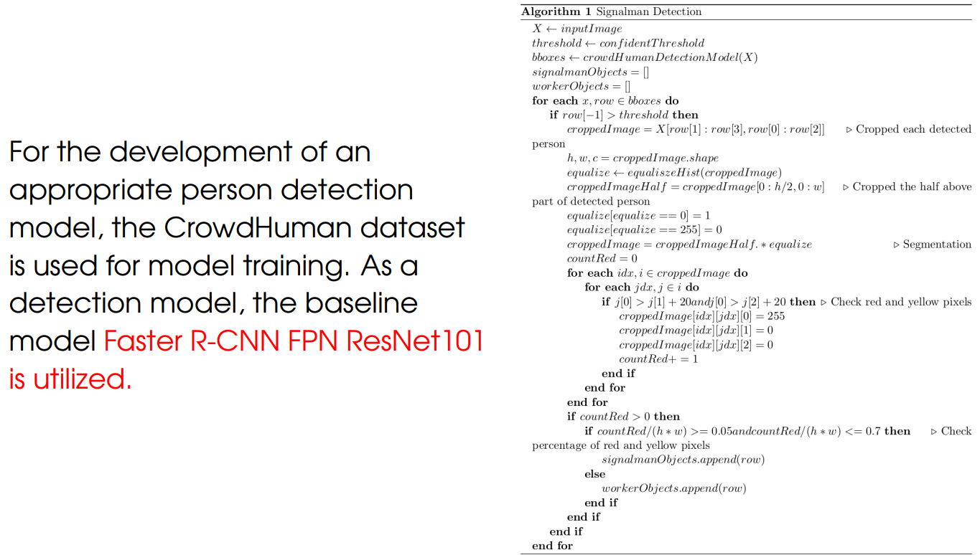
Signalman detection progress
June 3, 2022
SmartInsideAI

Slide 7
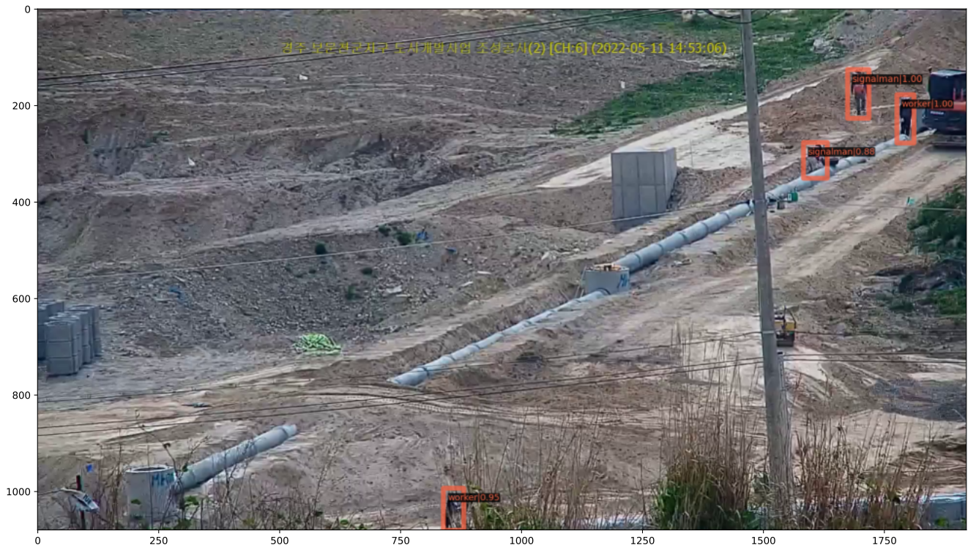
Signalman detection progress
June 3, 2022
SmartInsideAI

Slide 8
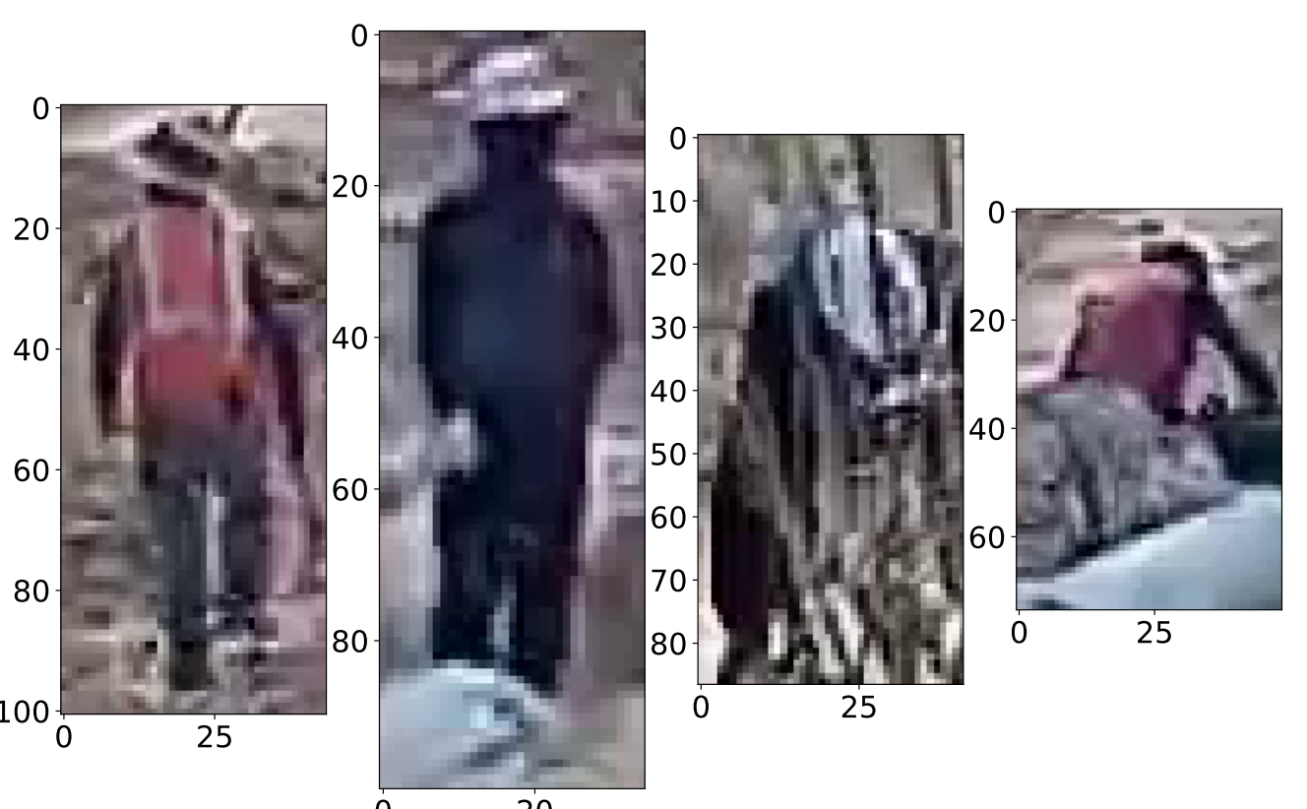
Signalman detection progress
June 3, 2022
SmartInsideAI

Slide 9
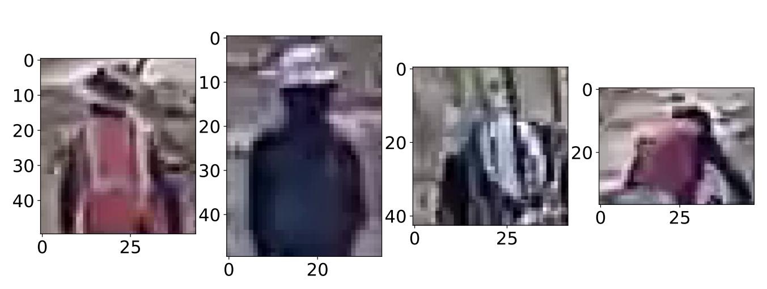
Signalman detection progress
June 3, 2022
SmartInsideAI

Slide 10
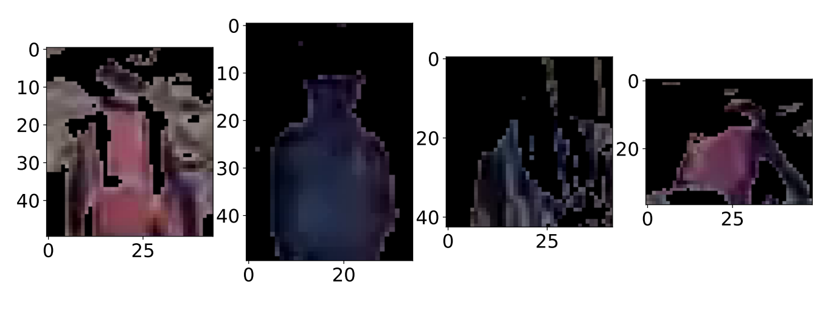
Signalman detection progress
Segmentation for improving accuracy
June 3, 2022
SmartInsideAI

Slide 11
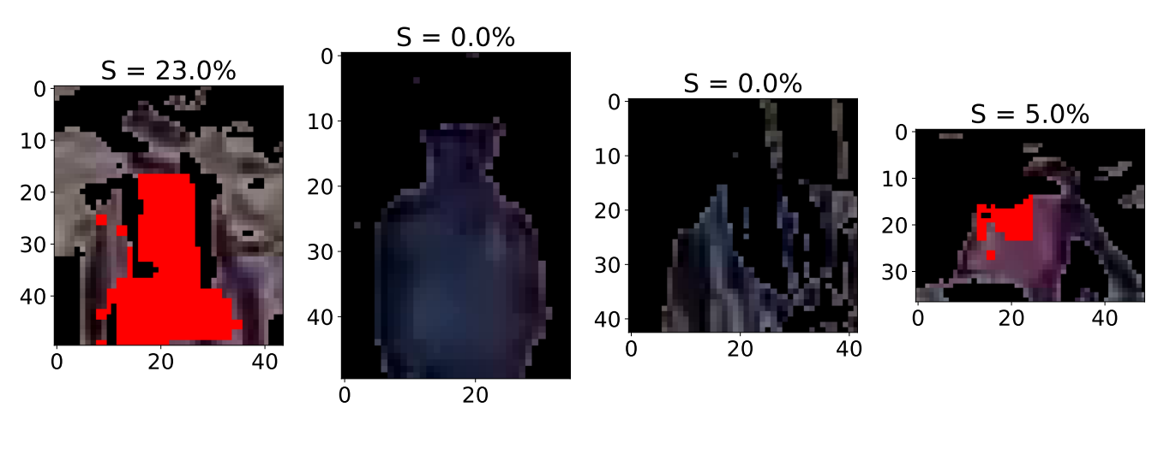
Signalman detection progress
June 3, 2022
SmartInsideAI

Slide 12
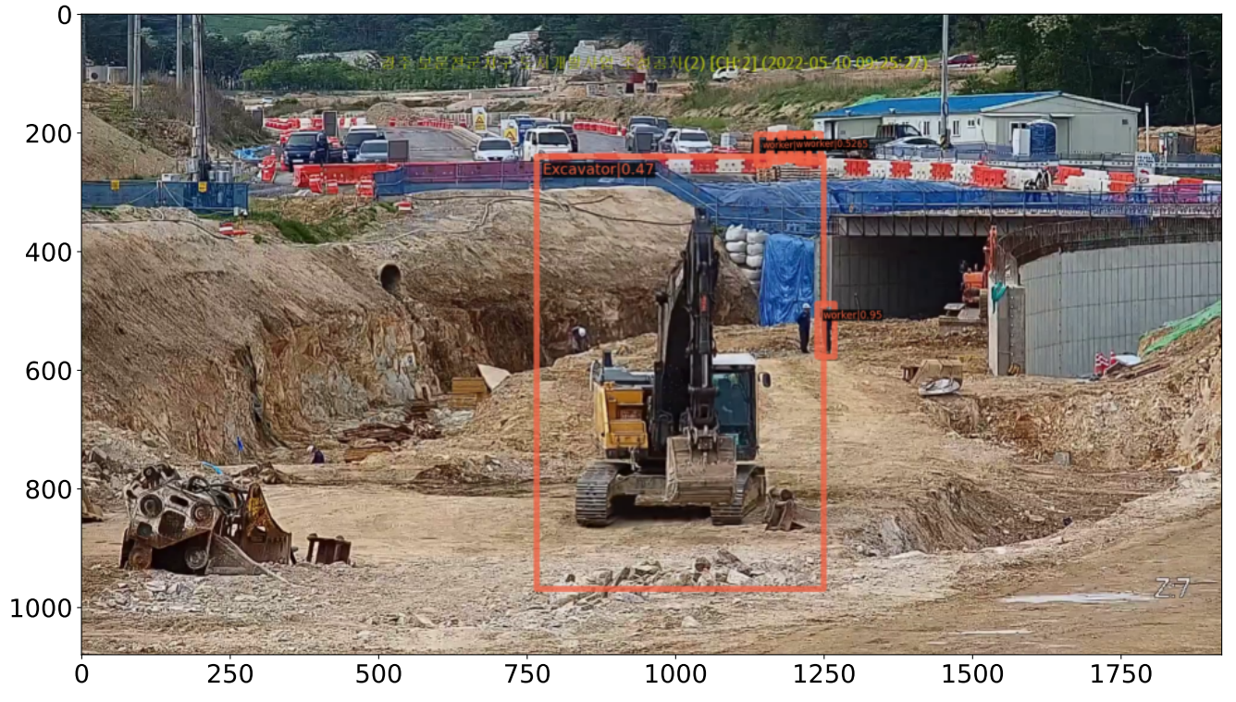
Signalman detection progress
June 3, 2022
SmartInsideAI

Slide 13
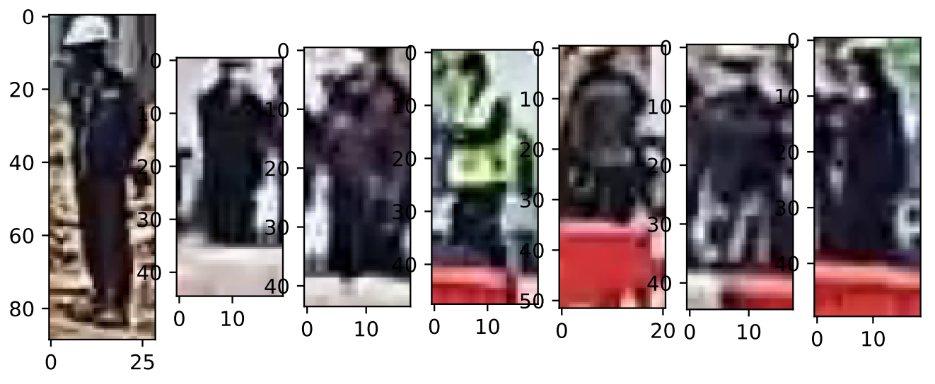
Signalman detection progress
June 3, 2022
SmartInsideAI

Slide 14
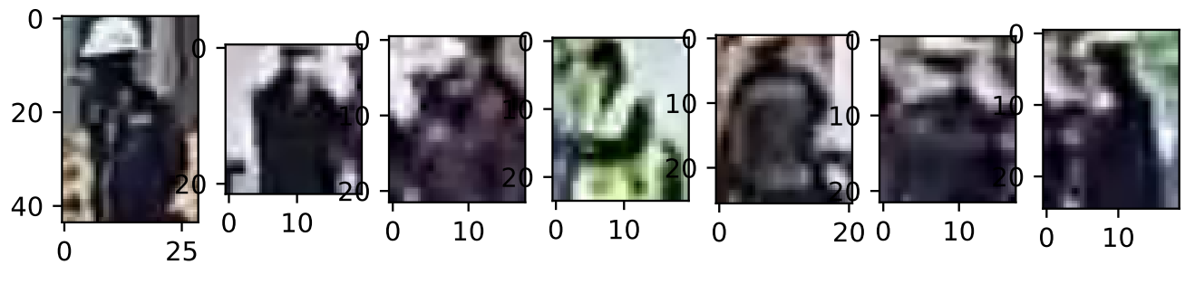
Signalman detection progress
June 3, 2022
SmartInsideAI

Slide 15
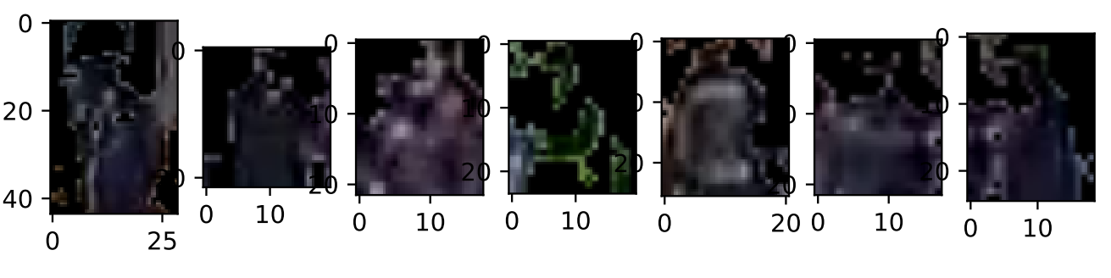
Signalman detection progress
June 3, 2022
SmartInsideAI

Slide 16
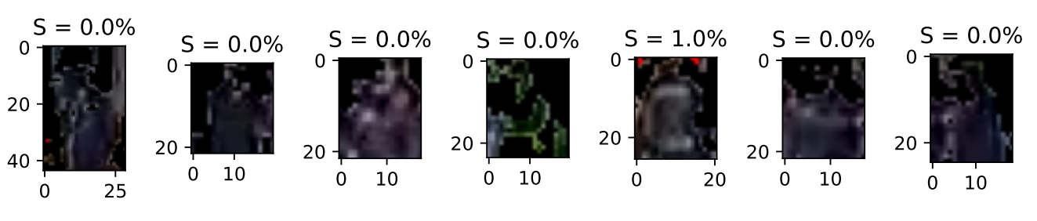
Signalman detection progress
June 3, 2022
SmartInsideAI

