Slide 1

Presentation Outline
Vehicle detection progress
Signalman detection progress
May 27, 2022
SmartInsideAI

Slide 2
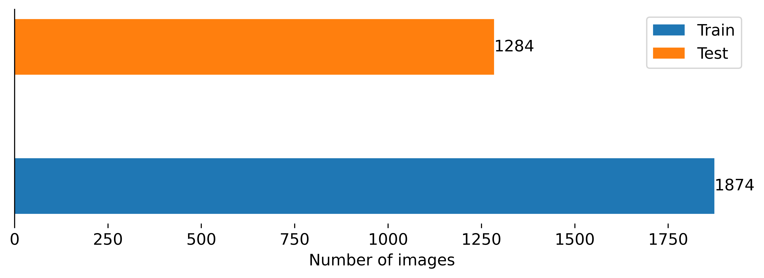
Vehicle detection
Labeling
progress
May 27, 2022
SmartInsideAI

Slide 3
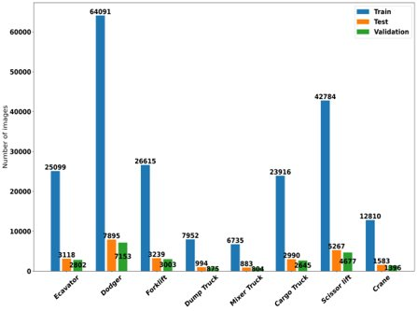
Vehicle detection
Compare with AIHub dataset
x18
May 27, 2022
SmartInsideAI

Slide 4
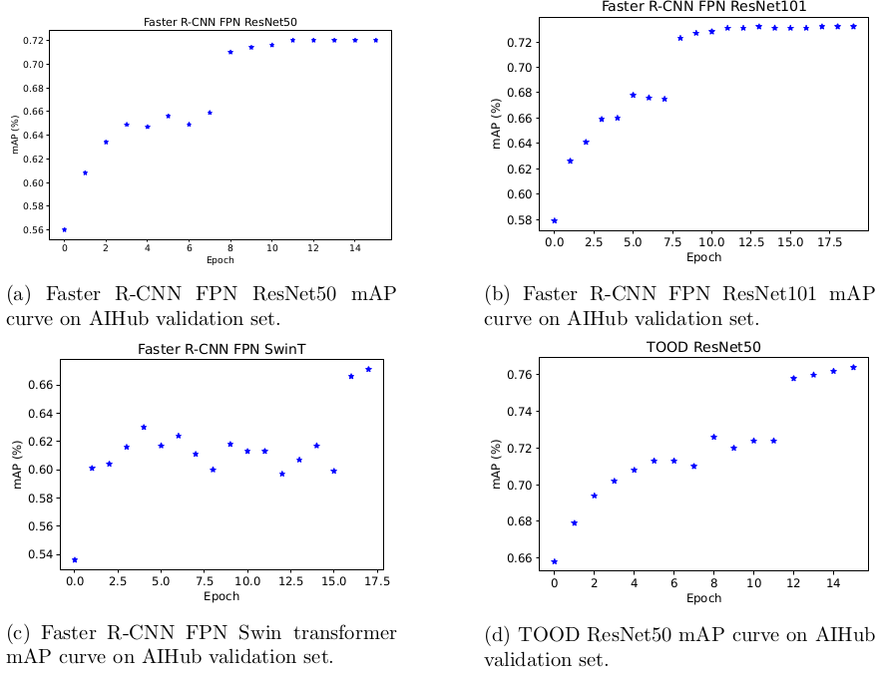
Vehicle detection
May 27, 2022
SmartInsideAI

Slide 5
Vehicle detection
Model | Evaluation set on CCTV data | AP |  |  |  |  |  |  |  | mAP
 |  | Excavator | Dodger | Forklift | Dump Truck | Mixer Truck | Cargo Truck | Scissor lift | Crane
FasterRCNN ResNet50 | Train | 0.174 | 0 | 0.217 | 0.011 | 0.84 | 0 | nan | nan | 0.207
 | Test | 0.092 | 0.004 | 0 | 0.018 | 0.04 | 0.069 | 0.489 | 0.096 | 0.101
FasterRCNN ResNet101 | Train | 0.14 | 0 | 0.197 | 0.017 | 0.678 | 0 | nan | nan | 0.172
 | Test | 0.075 | 0.001 | 0.017 | 0.006 | 0.048 | 0.035 | 0.467 | 0.138 | 0.098
FasterRCNN SwinT | Train | 0.224 | 0 | 0.234 | 0 | 0.517 | 0 | nan | nan | 0.163
 | Test | 0.073 | 0 | 0 | 0.001 | 0.013 | 0.051 | 0.504 | 0.157 | 0.100
TOOD ResNet50 | Train | 0.217 | 0.001 | 0.074 | 0.012 | 0.499 | 0.001 | nan | nan | 0.134
 | Test | 0.167 | 0.012 | 0.002 | 0.026 | 0.095 | 0.06 | 0.44 | 0.15 | 0.119
May 27, 2022
SmartInsideAI

Slide 6
Vehicle detection
Finetune
Model | Evaluation set on CCTV data | AP |  |  |  |  |  |  |  | mAP
 |  | Excavator | Dodger | Forklift | Dump Truck | Mixer Truck | Cargo Truck | Scissor lift | Crane
FasterRCNN ResNet50 Fine tune on Test | Train | 0.293 | 0.003 | 0.211 | 0.107 | 0.845 | 0 | nan | nan | 0.243
FasterRCNN ResNet50 Fine tune on Train | Test | 0.27 | 0.059 | 0.003 | 0.123 | 0.076 | 0.101 | 0.468 | 0.052 | 0.144
May 27, 2022
SmartInsideAI

Slide 7
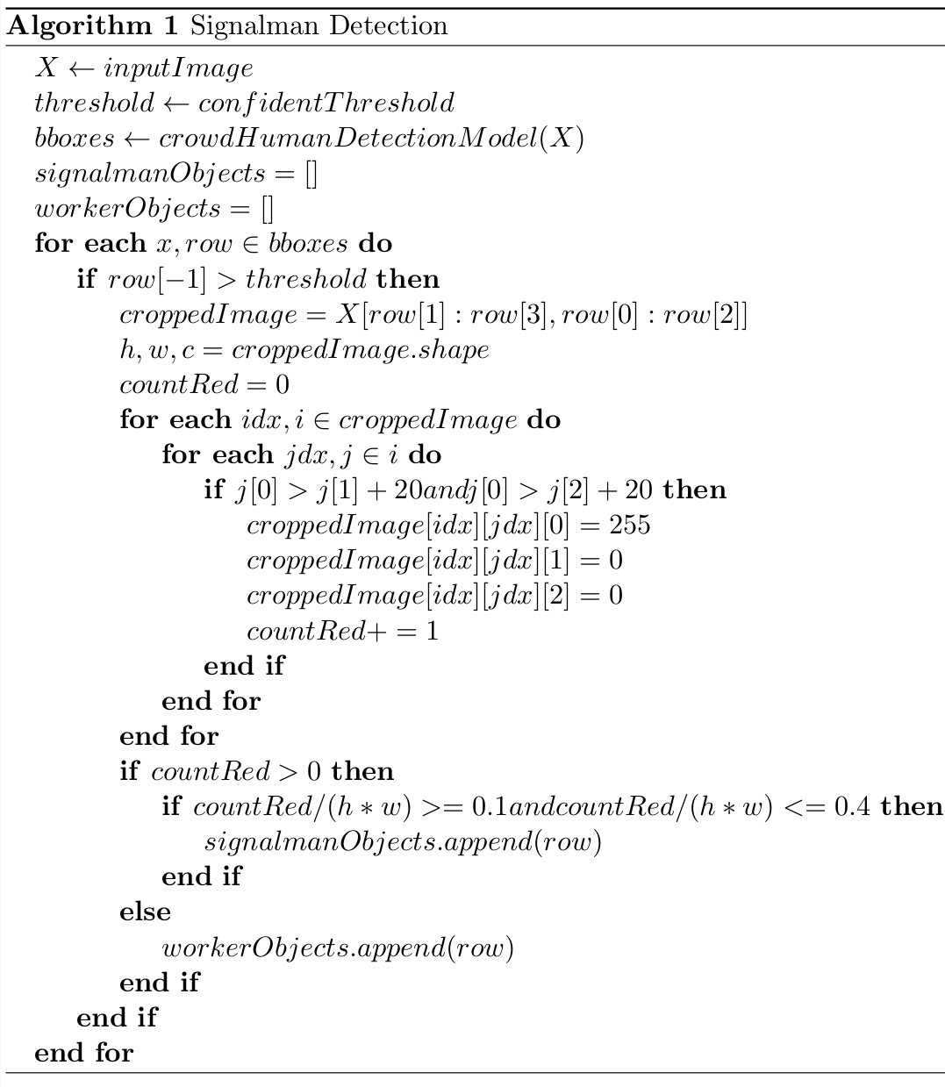
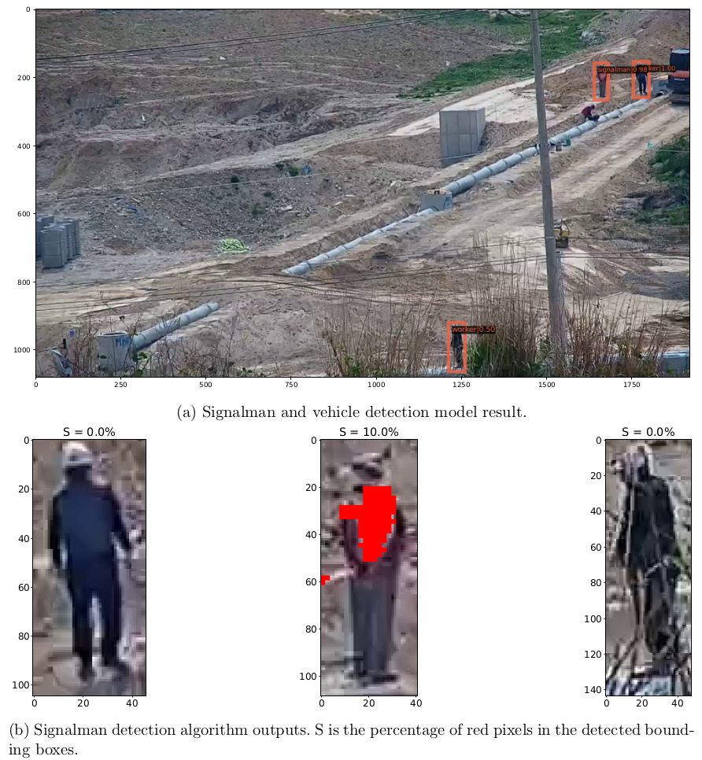
Signalman detection
May 27, 2022
SmartInsideAI

Slide 8
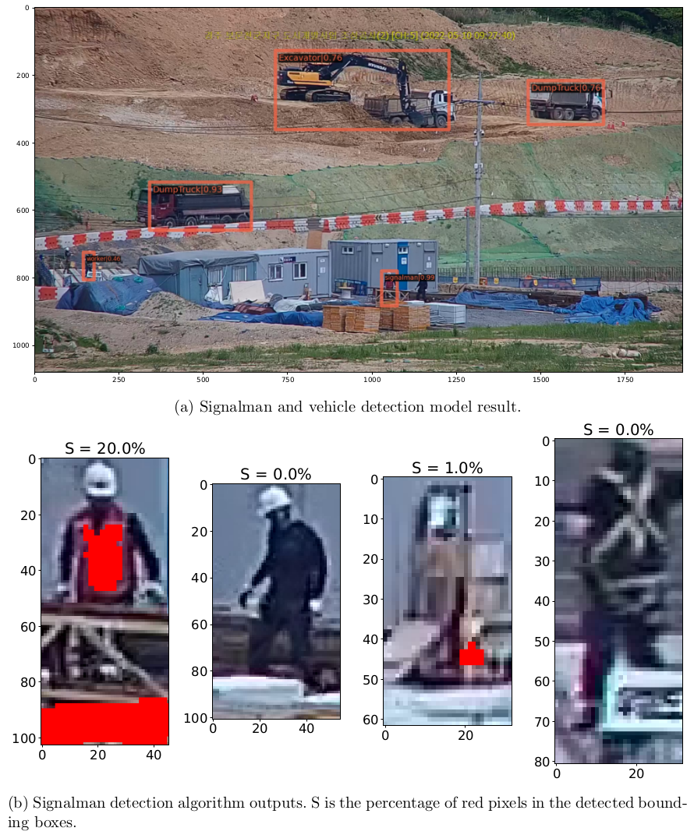
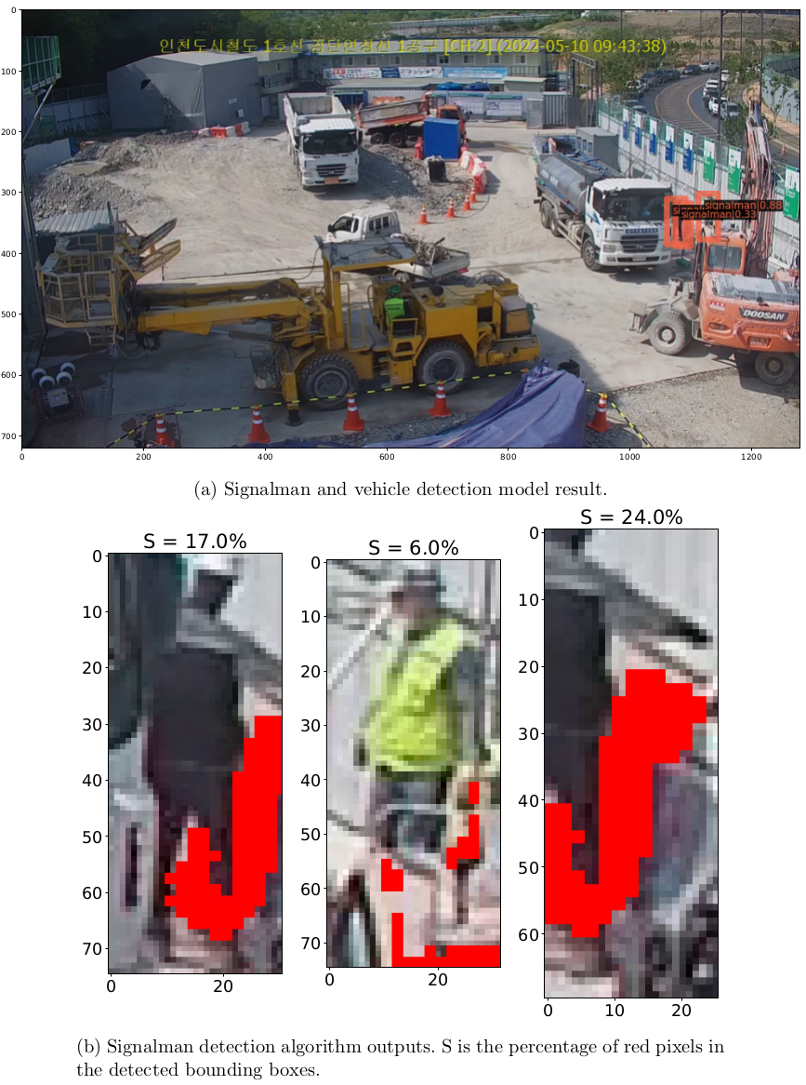
Signalman detection
May 27, 2022
SmartInsideAI

Slide 9
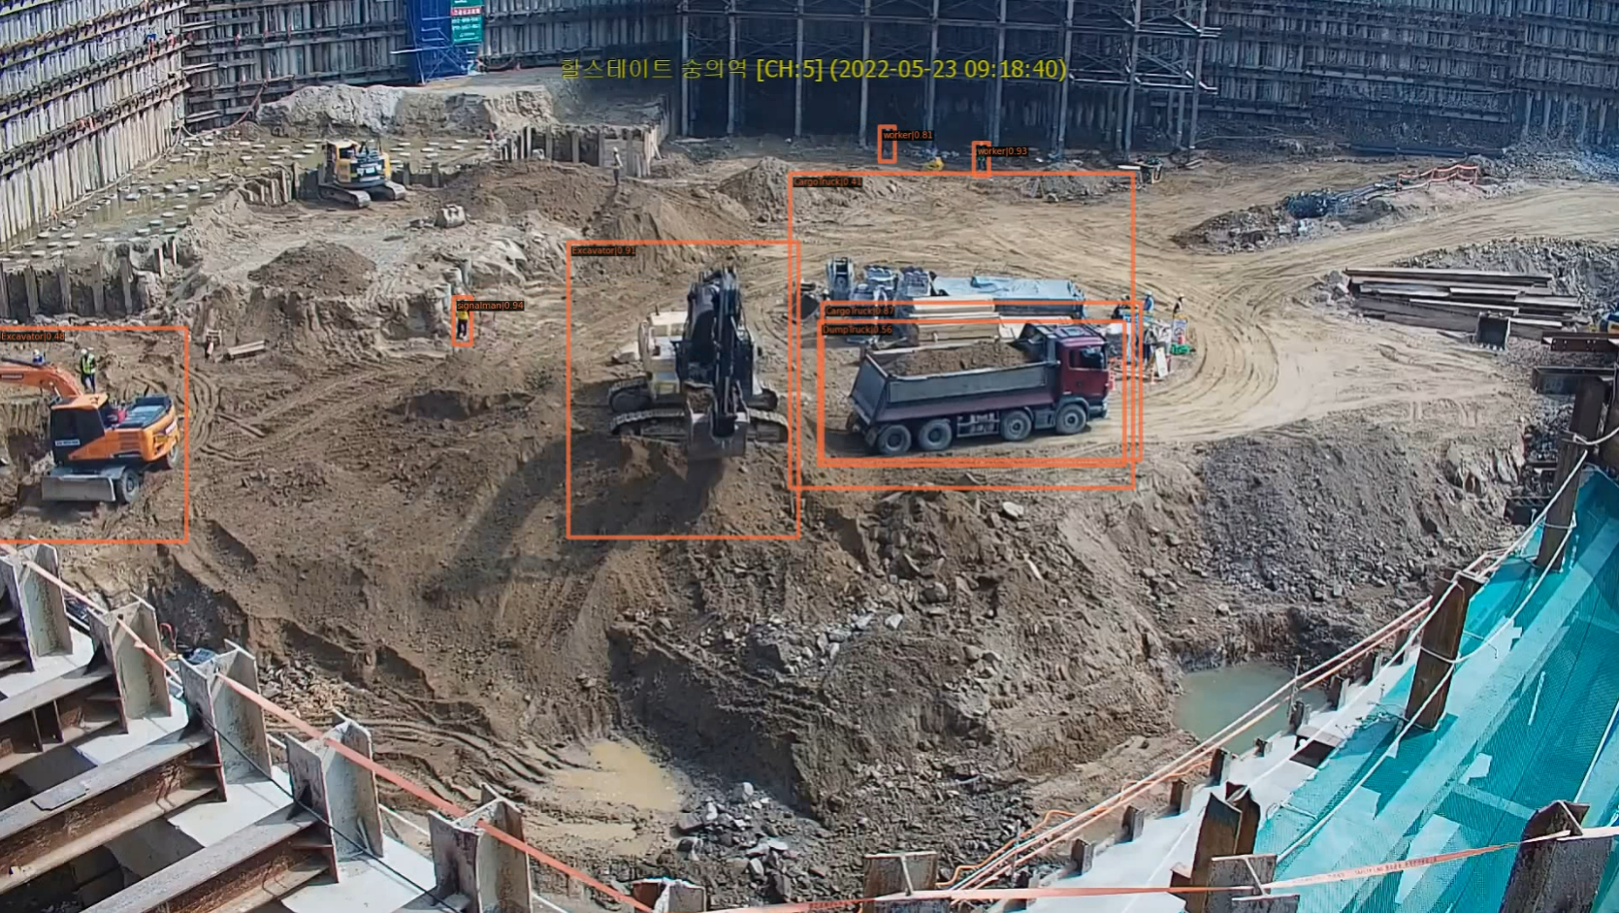

Combine models performance
May 27, 2022
SmartInsideAI

