Slide 1

Presentation Outline
Vehicle detection progress
Signalman detection progress

Slide 2
Vehicle detection progress
Train/val/test class distribution for baseline model training
CCTV Labeled dataset
AIHub dataset

Slide 3
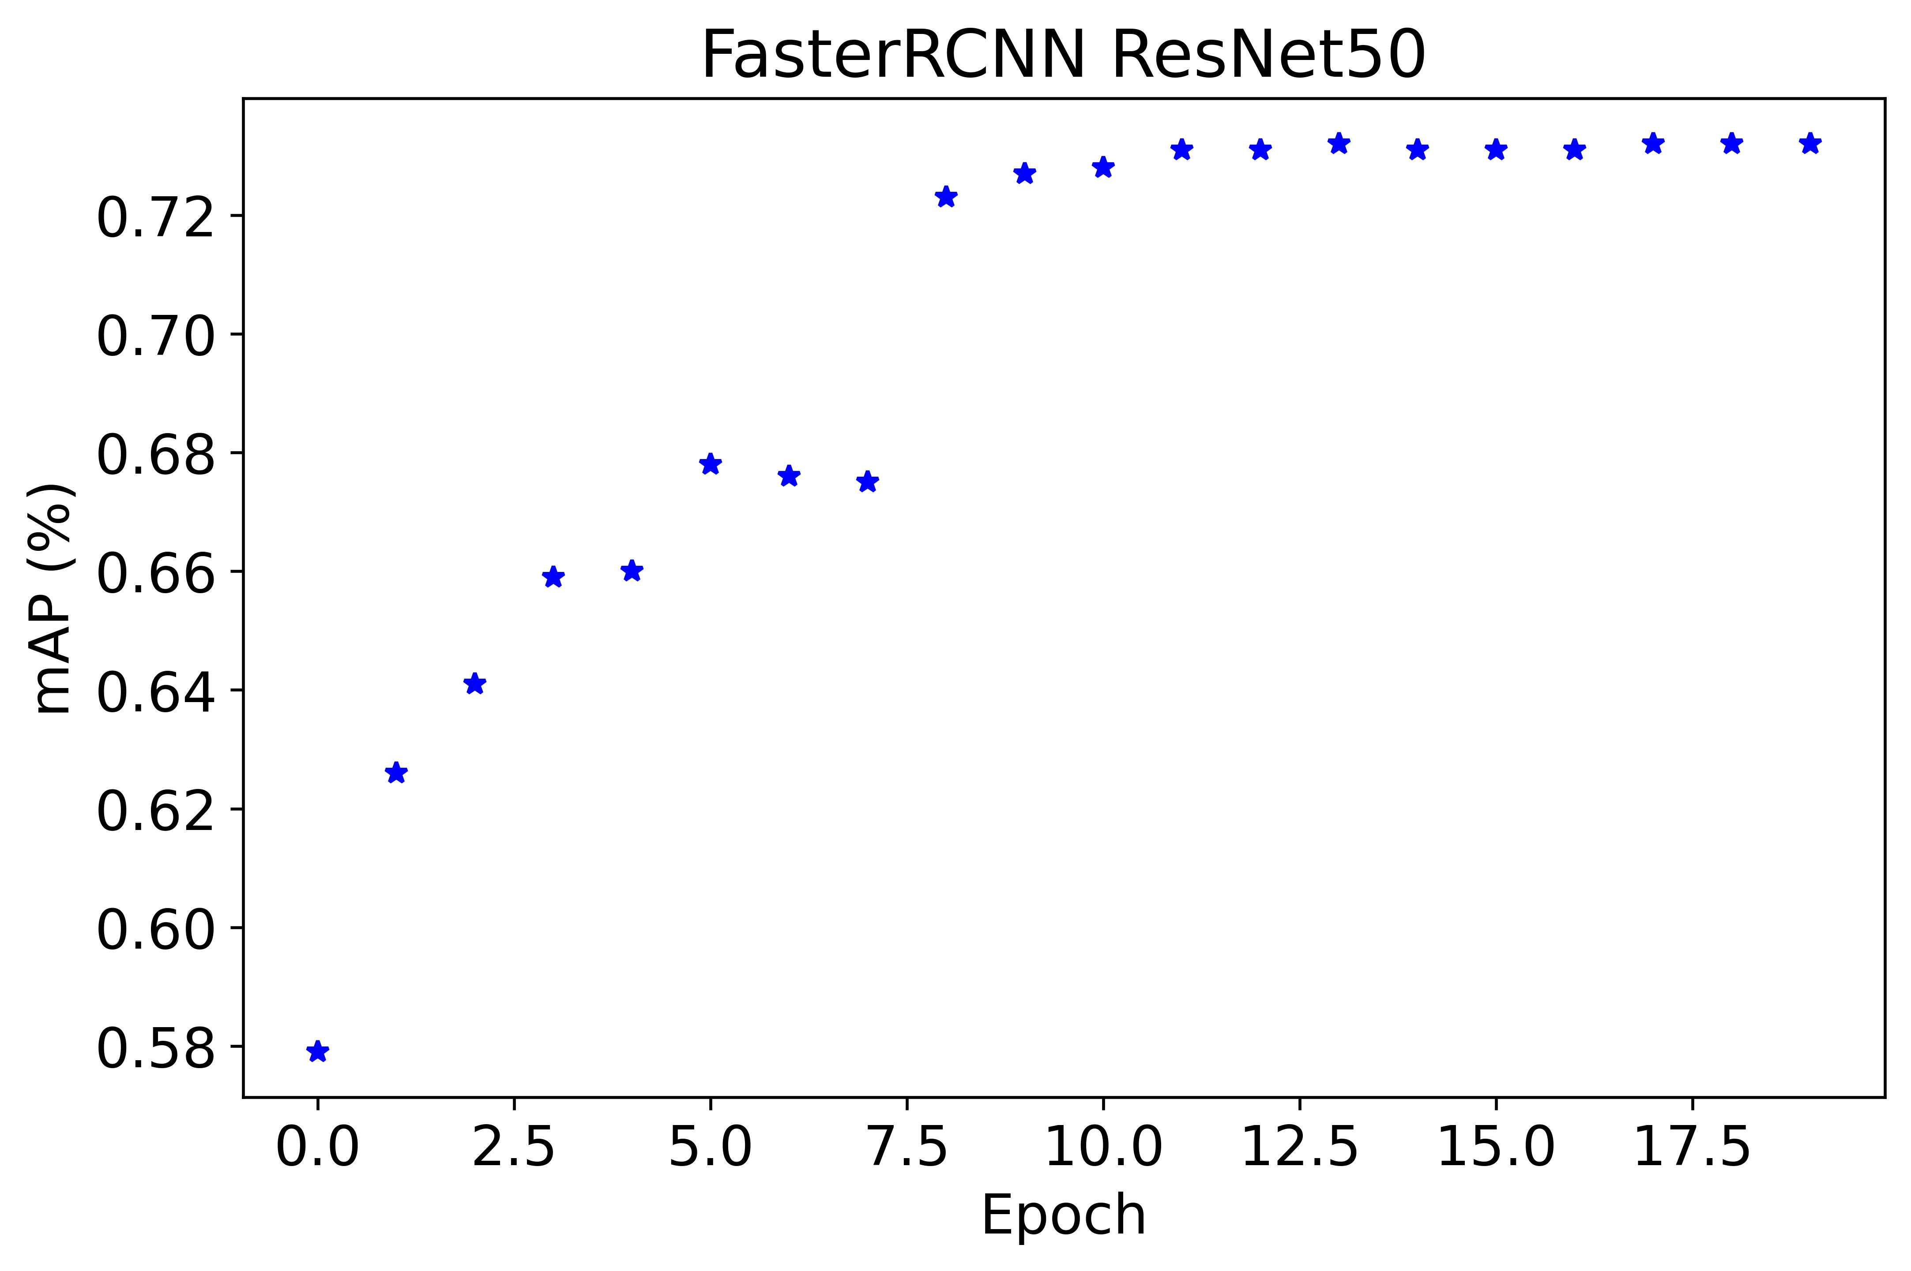
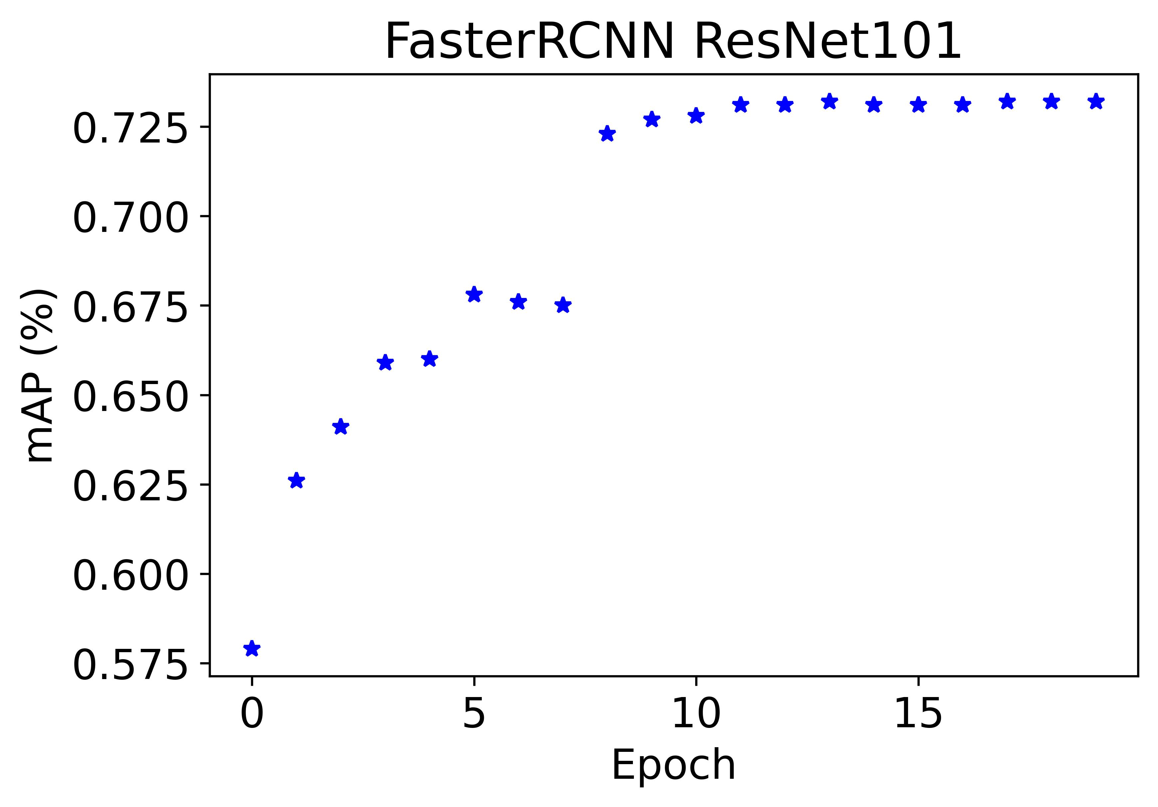
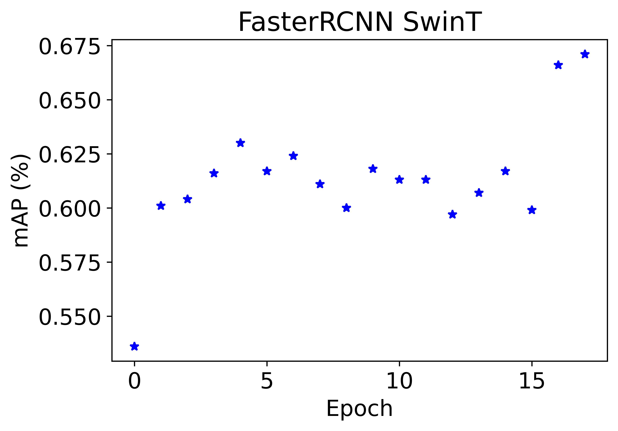
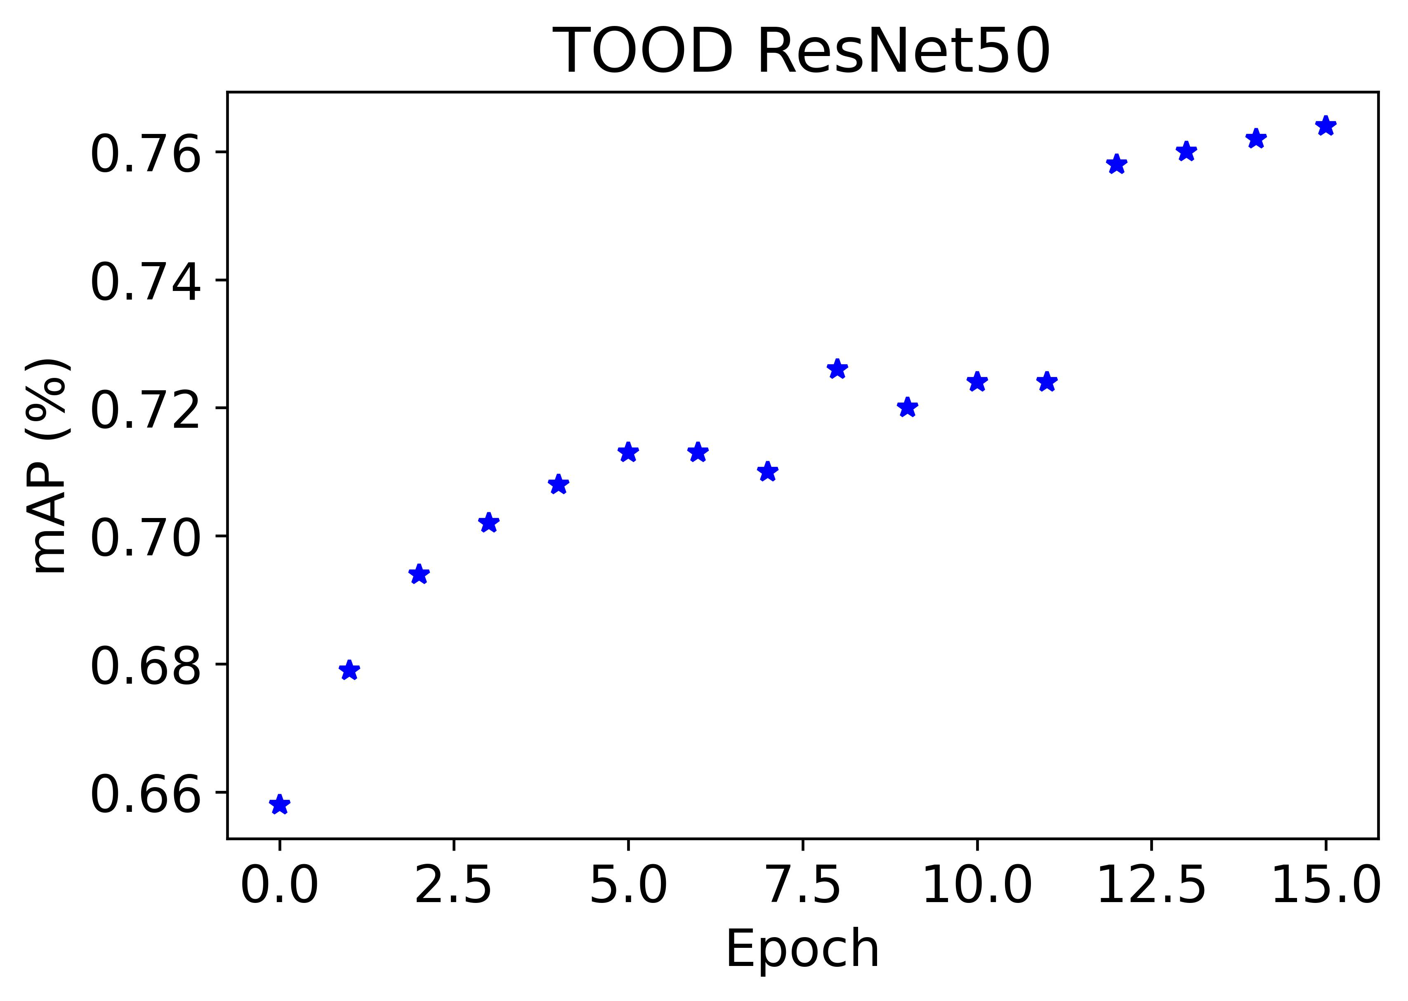
Vehicle detection progress
AIHub model performance on validation set

Slide 4
Vehicle detection progress
Model performance with average precision (AP) metric
 | Model | Evaluation set on CCTV data | AP
 |  |  | Excavator | Dodger | Forklift | Dump Truck | Mixer Truck | Cargo Truck | Scissor lift | Crane
Train on AIHub dataset | FasterRCNN ResNet50 | Train | 0.064 | 0.007 | 0 | 0.067 | 0.823 | 0 | nan | nan
 |  | Test | 0.218 | 0 | 0.217 | 0.011 | nan | nan | nan | nan
 | FasterRCNN ResNet101 | Train | 0.034 | 0.001 | 0 | 0 | 0.491 | 0 | nan | nan
 |  | Test | 0.183 | 0 | 0.197 | 0.017 | nan | nan | nan | nan
 | FasterRCNN SwinT | Train | 0.033 | 0 | 0.001 | 0 | 0.669 | 0 | nan | nan
 |  | Test | 0.23 | 0 | 0.234 | 0.004 | nan | nan | nan | nan
 | TOOD ResNet50 | Train | 0.2 | 0.016 | 0 | 0.014 | 0.502 | 0 | nan | nan
 |  | Test | 0.245 | 0.001 | 0.074 | 0.012 | nan | nan | nan | nan
 | Softteacher ResNet50 (Semi supervised) | Train | 0.28 | 0 | 0 | 0.005 | 0.731 | 0 | nan | nan
 |  | Test | 0.155 | 0 | 0.203 | 0.005 | nan | nan | nan | nan
Train on CCTV dataset | FasterRCNN train on CCTV | Test | 0.03 | 0.017 | 0 | 0.009 | nan | nan | nan | nan

Slide 5
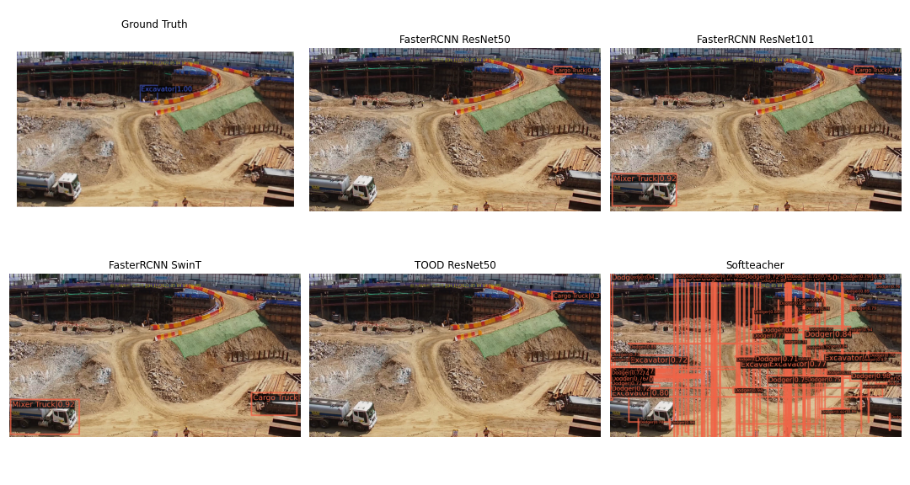
Vehicle detection progress
Visualize predicted images with ground truth

Slide 6
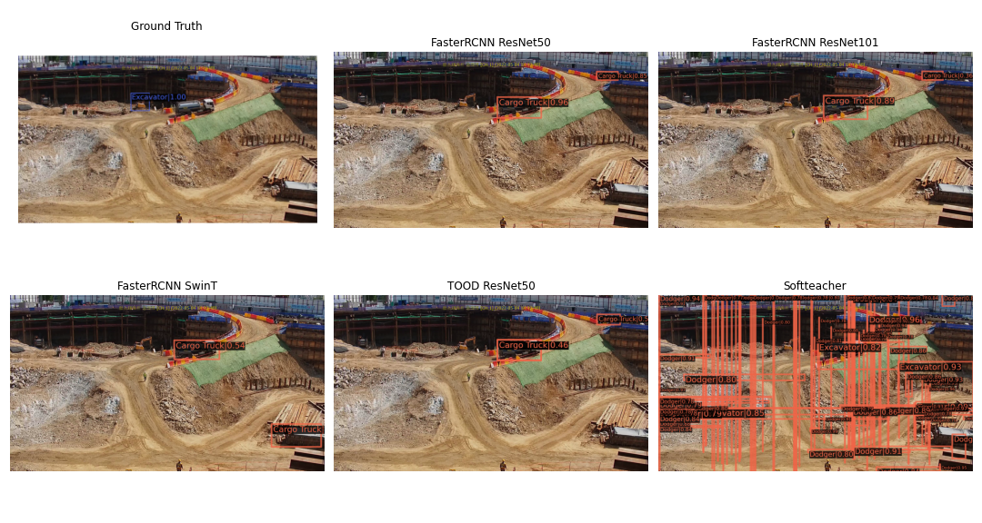
Vehicle detection progress
Visualize predicted images with ground truth

Slide 7
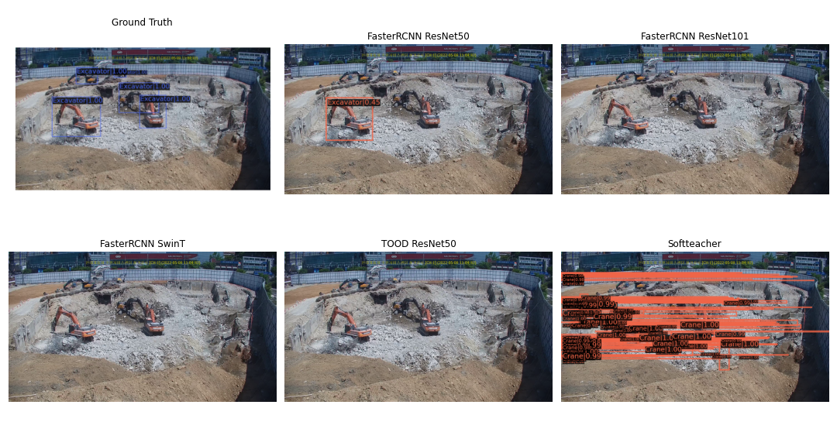
Vehicle detection progress
Visualize predicted images with ground truth

Slide 8
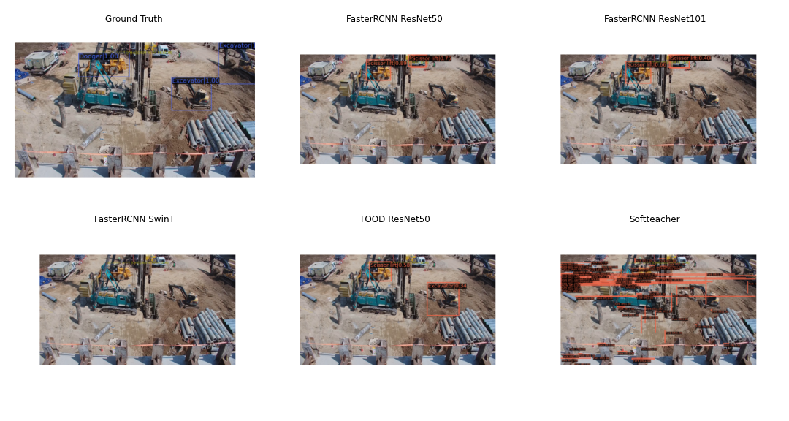
Vehicle detection progress
Visualize predicted images with ground truth

Slide 9
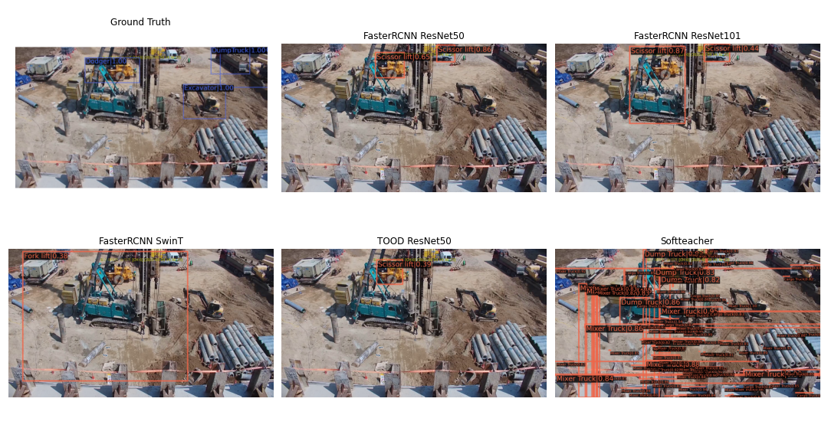
Vehicle detection progress
Visualize predicted images with ground truth

Slide 10
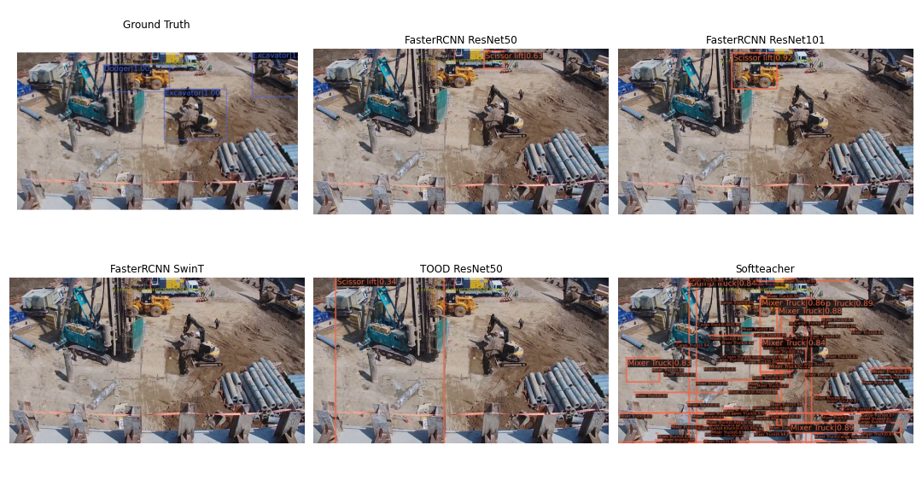
Vehicle detection progress
Visualize predicted images with ground truth

Slide 11
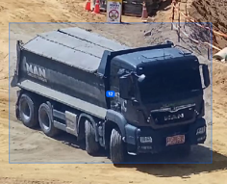
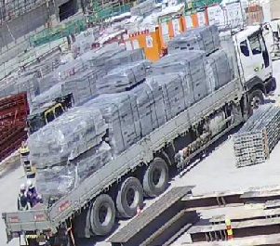
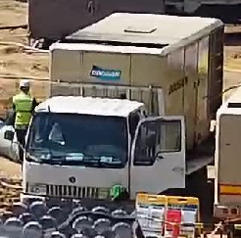
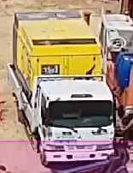
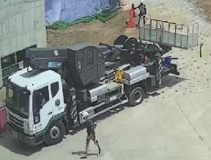
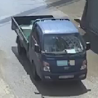
Vehicle detection progress
Labeling problem
labled
unlabeld
Num class: 12
Object: dump Truck
Num class: 16
Object: Cargo Truck
Confused object
Request to add or combine classes

Slide 12
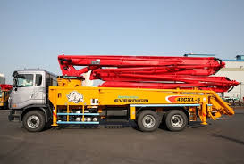
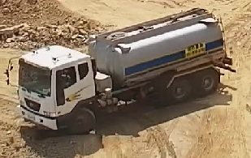
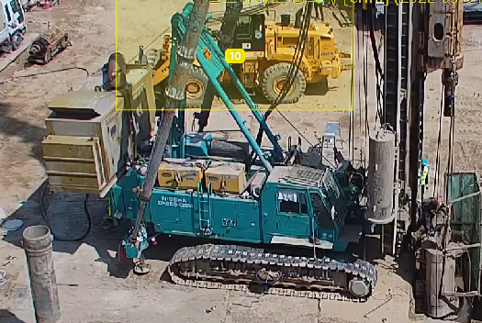
Vehicle detection progress
Labeling problem
Request to add or combine classes

Slide 13
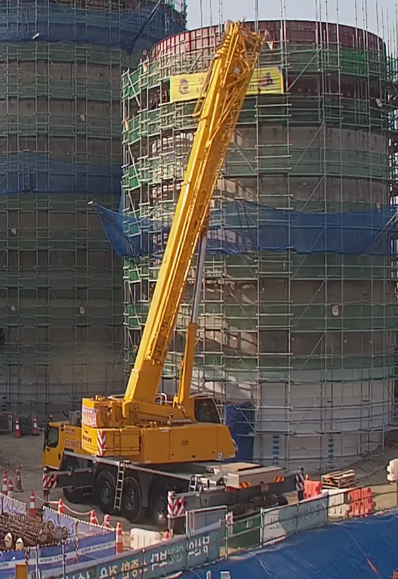
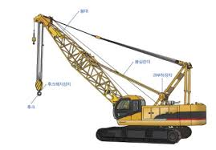
Vehicle detection progress
Labeling problem

Slide 14
Vehicle detection progress
Improving model performance
Label common and uncommon classes (dump truck and cargo truck?)
Train with CCTV dataset
Train with CCTV + AIHub dataset
Neural architecture search with CCTV dataset
Data analysis for class unbalance
Domain adaptation

Slide 15
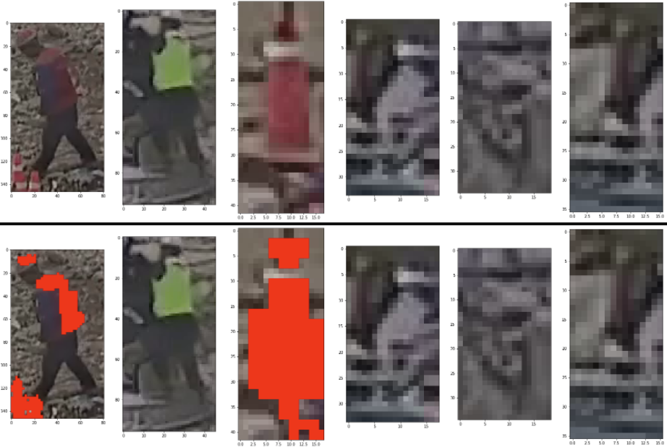
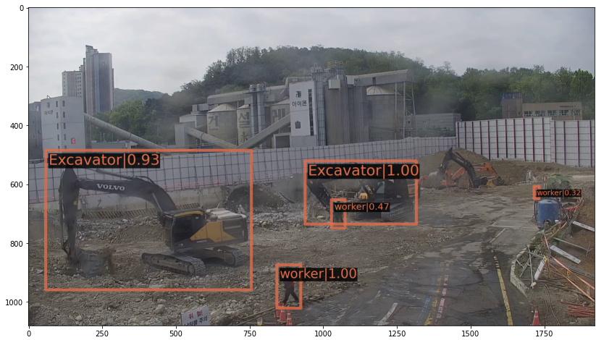
Signalman detection progress
Detect then crop then identify red pixels

Slide 16
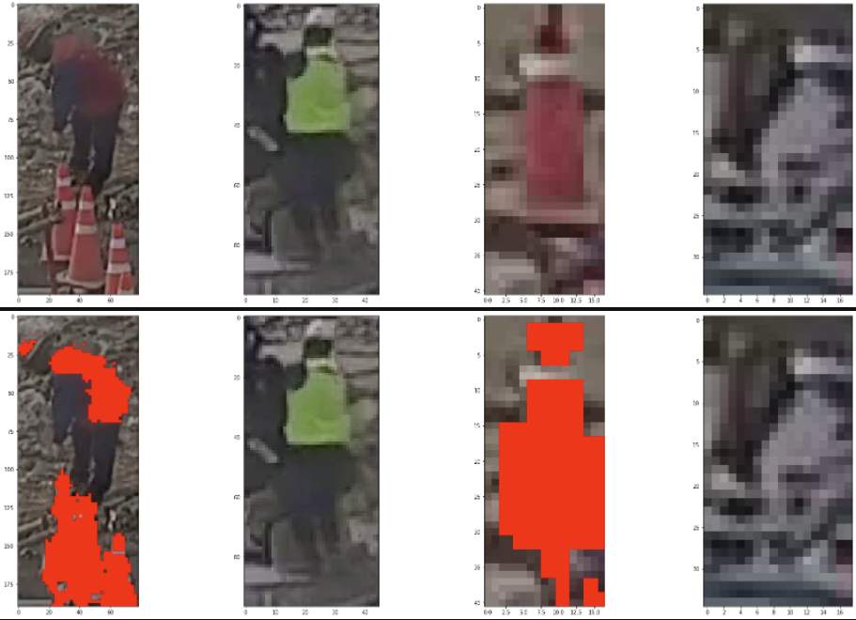
Signalman detection progress
Detect then crop then identify red pixels

Slide 17
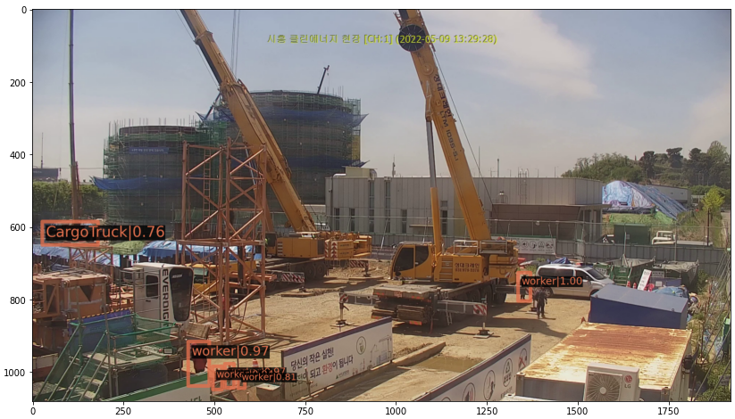
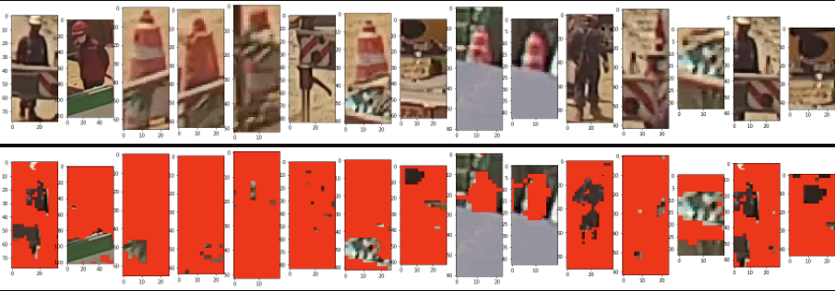
Signalman detection progress
Detect then crop then identify red pixels

Slide 18
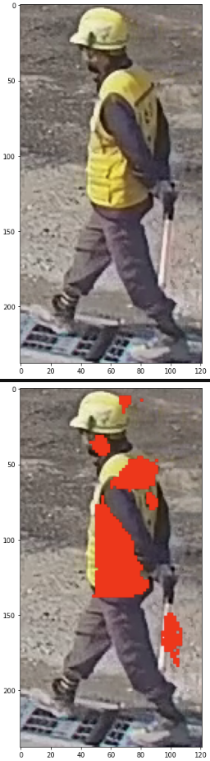
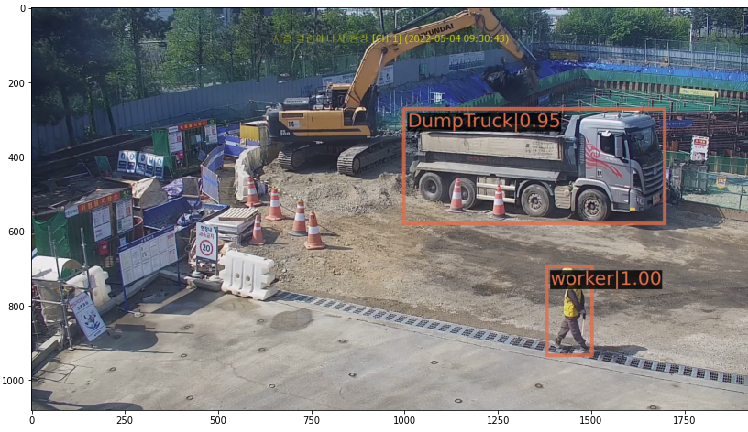
Signalman detection progress
Detect then crop then identify red pixels

Slide 19
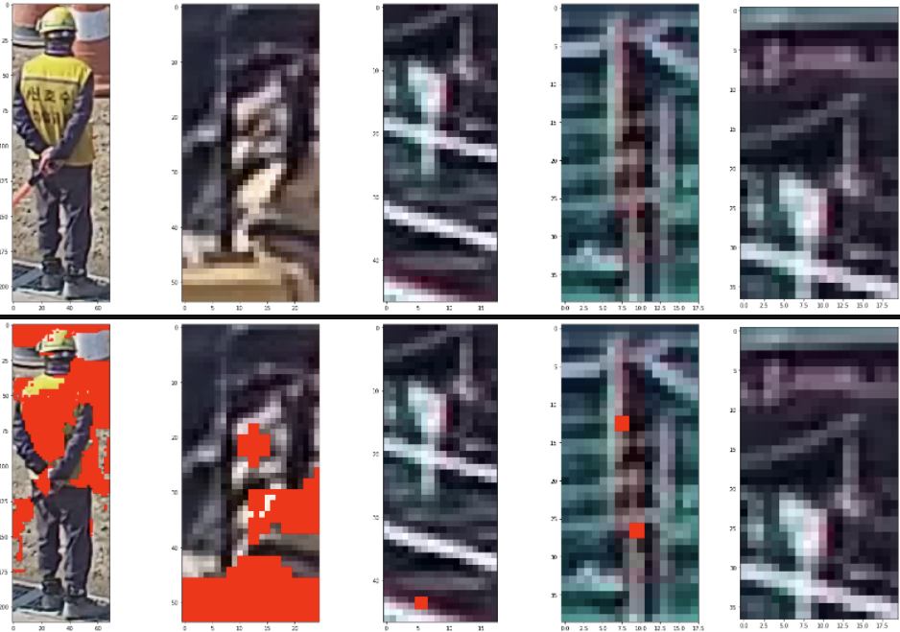
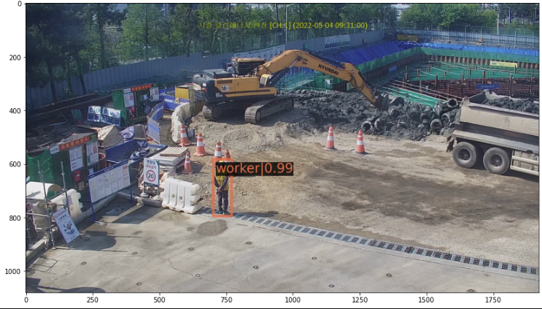
Signalman detection progress
Detect then crop then identify red pixels

Slide 20
Signalman detection progress
Improving model performance
Train with CCTV worker samples
Neural architecture search

Slide 21
Signalman detection progress
Next steps
Identify distance between signalman or worker with vehicles?
Warning distance
Dangerous zone warning
Missing signalman warning

Slide 22
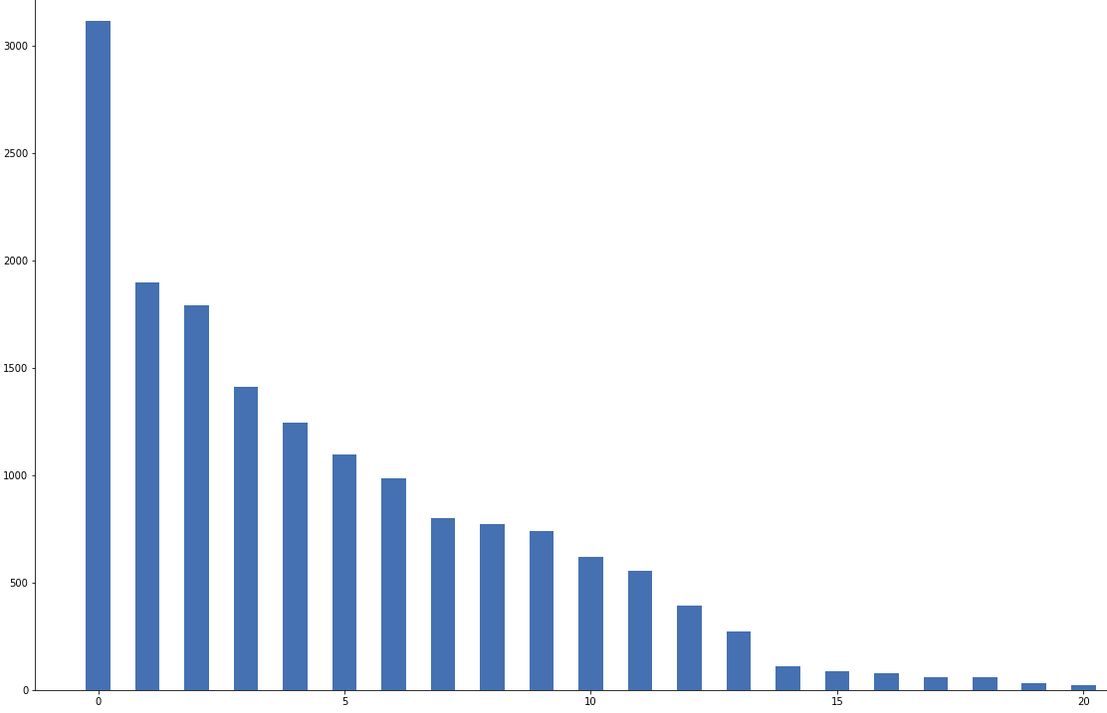
Safety regulation violation
Proposed approach
Input image -> output: 재해종류?
Or....
재해종류

